Slide 1
Chapter 5 Malicious Codes (Malware)

Slide 2
Outline
What is a malware?
Common types of malware
How to detect & prevent them?

Slide 3
Sample infection process
Users visit FB or look for news using search engines
Users click the malicious URL and download a file
It displays graphical user interface (GUI) on the infected system’s Web browser.
It shows fake alerts that warn users of system infection. It also displays fake scanning results.
It asks users to purchase o rogue antivirus software. Once purchased, they are pointed to a site that asks for sensitive information such as credit card numbers.

Slide 4
What is a malware?
A malware is a set of instructions that run on your computer and make your system do something that an attacker wants it to do.

Slide 5
What is a malware?
A broad category of software threats to your network and systems.
Modifies or destroys data
Steals data
Allows unauthorized access
Exploit or damages a system

Slide 6
Malware Types
Basic types:
Virus
Worms
Trojan Horse
Several variants of the basic types exist:
Time Bomb
Logic Bomb
Keylogger
Rootkit
Adware
Spyware
…

Slide 7

Keylogger

Slide 8
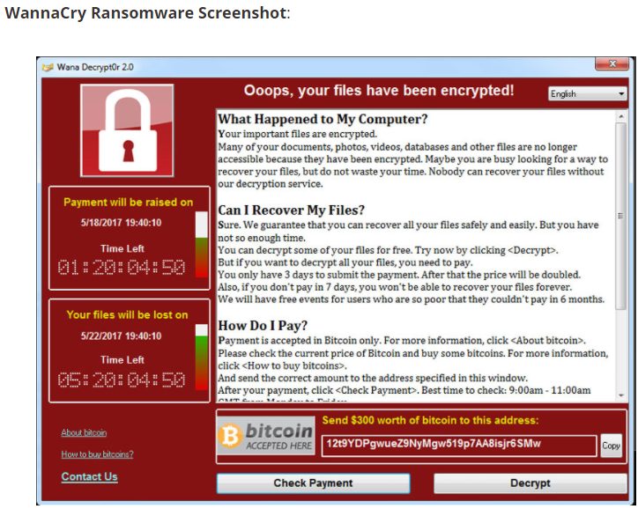

Slide 9
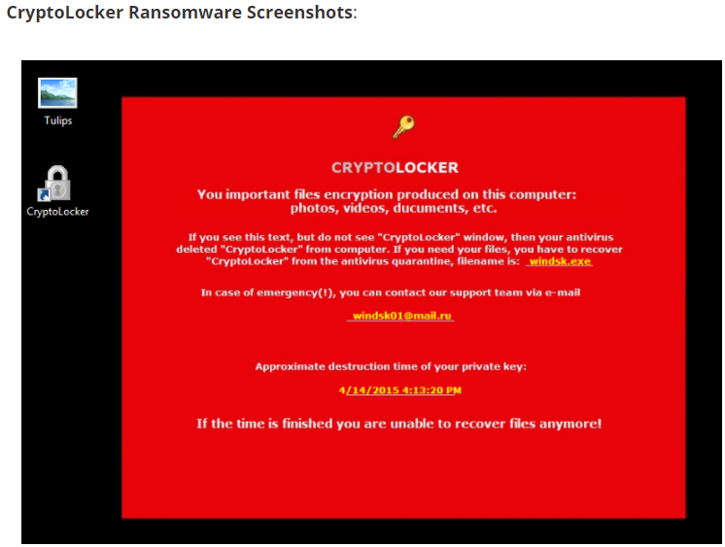

Slide 10
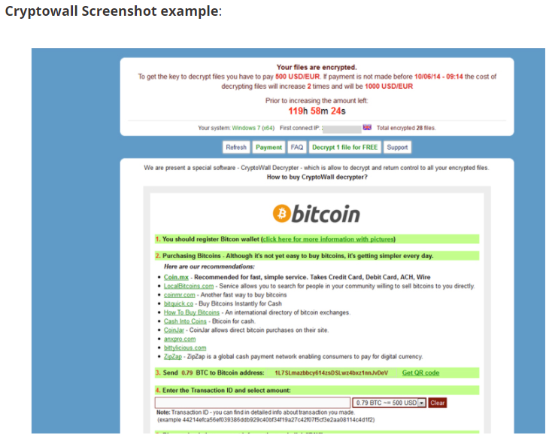

Slide 11
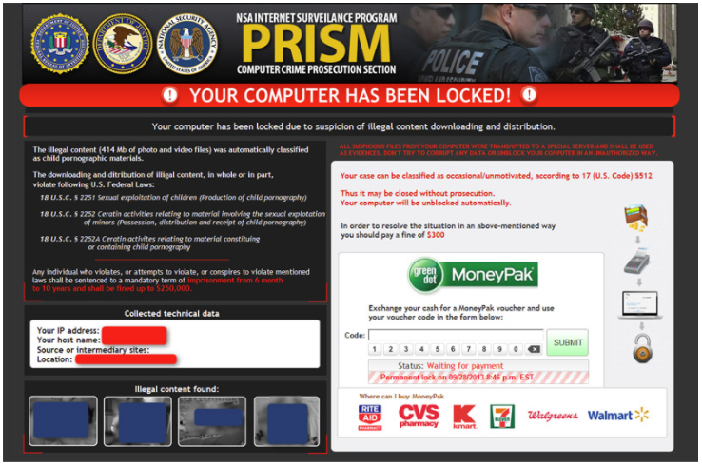

Slide 12
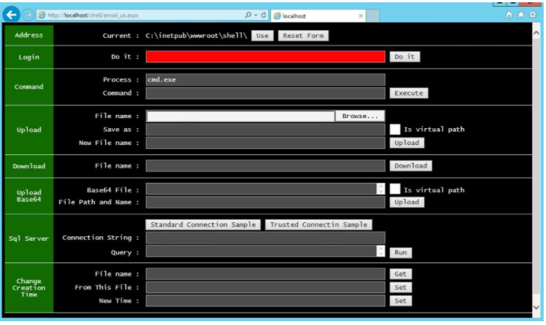

Slide 13
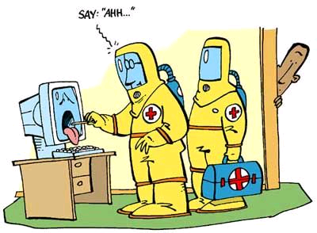
Virus
Virus: a program that attaches copies of itself into other programs.
Propagates and performs some unwanted function
Viruses are not programs
Definition from RFC 1135: A virus is a piece of code that inserts itself into a host [program], including operating systems, to propagate. It cannot run independently. It requires that its host program be run to activate it.

Slide 14
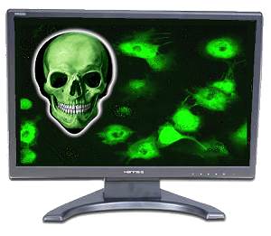
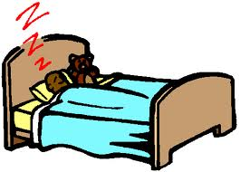
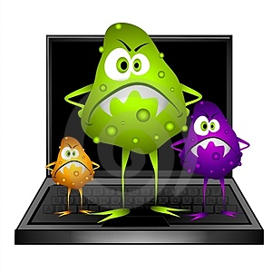
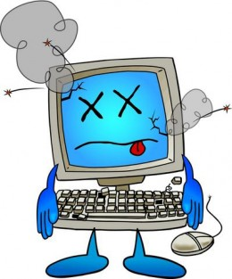
Four Phases of a Virus
The virus is activated to perform the function for which it was created
1. Dormant Phase
3. Triggering Phase
2. Propagation Phase
4. Execution Phase
The virus is idle
Not all viruses have this stage
the virus places an identical copy of itself into other programs of into certain system areas
The function is performed
The function may be harmless or damaging

Slide 15
Virus Types
Parasitic virus – ký sinh:
Attaches itself to a file and replicates when the infected program is executed
most common form
Memory resident virus:
lodged in main memory as part of a resident system program
Virus may infect every program that executes

Slide 16
Virus Types
Boot Sector Viruses:
Infects the boot record and spreads when system is booted
Gains control of machine before the virus detection tools
Very hard to notice
Macro Virus:
virus is part of the macro associated with a document

Slide 17
Virus Types
Stealth virus – tàng hình:
A form of virus explicitly designed to hide from detection by antivirus software
Polymorphic virus:
A virus that mutates with every infection making detection by the “signature” of the virus difficult
Mutate: đột biến

Slide 18
How Viruses Append
+
virus
=
virus
Original
program
Original
program
Virus appended to program

Slide 19
How Viruses Append
+
virus
=
Virus-1
Original
program
Original
program
Virus-2
Virus surrounding a program

Slide 20
How Viruses Append
+
=
Virus-1
virus
Original
program
Virus-2
Original
program
Virus-3
Virus-4
Virus integrated into program

Slide 21
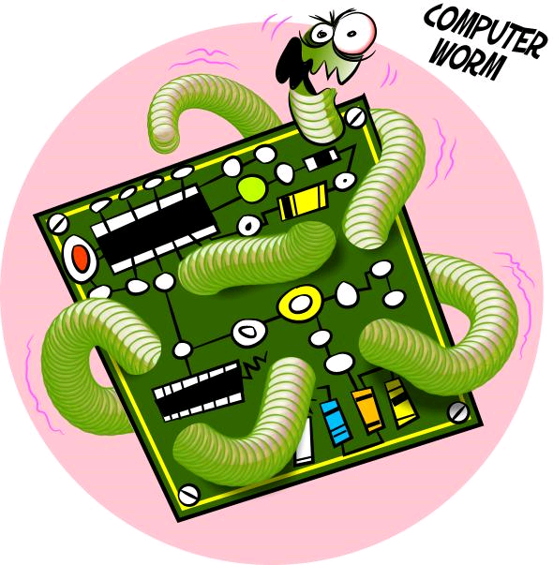
Worm
Worm: a program that propagates copies of itself through the network.
Independent program.
May carry other code, including programs and viruses.
Definition from RFC 1135: A worm is a program that can run independently, will consume the resources of its host [machine] from within in order to maintain itself and can propagate a complete working version of itself on to other machines.

Slide 22
Kinds of Malicious Code
Rabbit/Bacteria: make copies of themselves to overwhelm a computer system's resources
Denying the user access to the resources
Logic/Time Bomb: programmed threats that lie dormant for an extended period of time until they are triggered
When triggered, malicious code is executed

Slide 23
Kinds of Malicious Code
Trojan Horse: secret, undocumented routine embedded within a useful program
Execution of the program results in execution of secret code
Rootkit: Rootkits are designed to conceal certain objects or activities in your system. Often their main purpose is to prevent malicious programs being detected – in order to extend the period in which programs can run on an infected computer
Spyware: Software which sends information to its creators about a user's activities (e.g., passwords, credit card numbers, and other information that can be sold on the black market.

Slide 24
Worm vs Virus vs Trojan horse
A virus is code embedded in a file or program
Viruses and Trojan horses rely on human intervention
Worms are self-contained and may spread autonomously

Slide 25
Where does Malicious Code Hide?
1. Email
2. Web Content
3. Legitimate Sites
4. File Downloads

Slide 26
How to detect & prevention them

Slide 27
A detection system may detect suspicious activities.
A prevention system must identify and stop malicious attacks before they do damage and have a chance to infect a system.

Slide 28
Anti-Virus
Analyze system behavior
Analyze binary to decide if it a virus
Type:
Scanner
Real time monitor

Slide 29
Techniques
Virus signature
Find a string that can identity the virus
Heuristics
Analyze program behavior (network access, file open, attempt to delete file, attempt to modify the boot sector,…)
Sandbox analysis
Running the executable in a VM
Observe it (file activity, network, memory,…)

Slide 30
Antivirus Approaches
Detection:
determine infection and locate the virus
Identification:
identify the specific virus
Removal:
remove the virus from all infected systems, so the disease cannot spread further
Recovery:
restore the system to its original state

Slide 31
Preventing Virus Infection
Prevention:
Good source of software installed
Isolated testing phase
Use virus detectors
Limit damage:
Make and retain backup copies important resources

Slide 32
Preventing Malicious Attacks on the Internet
All of your software is up-to-date
Install a firewall
Scanning systems for weak spots, like an operating system that has not been upgraded or recently patched

Slide 33
Q & A

